Slide 1
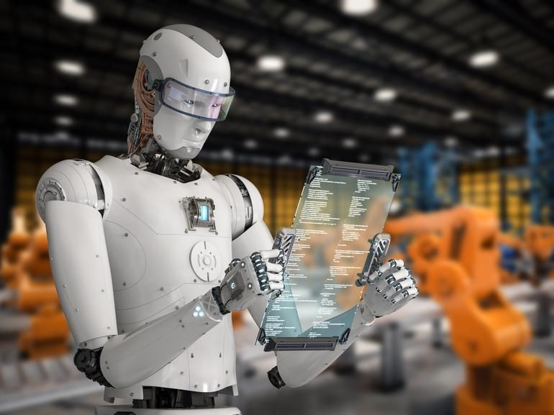
Question Answering: Learning to Answer from Text

Slide 2
Outline
What is Question Answering?
Search Engine vs. QA
IR based Approach for QA
  Motivation and History
  AskMSR: A shallow approach
  Common Evaluation Metrics
Machine Comprehension
  Motivation and History
  MC Datasets
  Machine Learning Approach
    Sliding Window
    Logistic Regression
  Deep Learning Approach
    Stanford Attentive Reader
    Stanford Attentive Reader++
    BiDAF
References

Slide 3
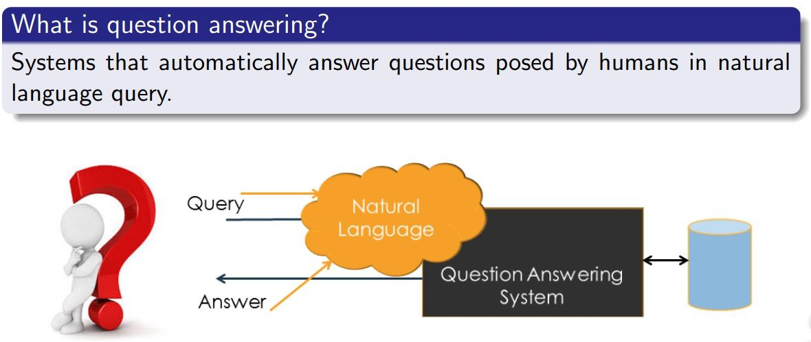
Question Answering

Slide 4
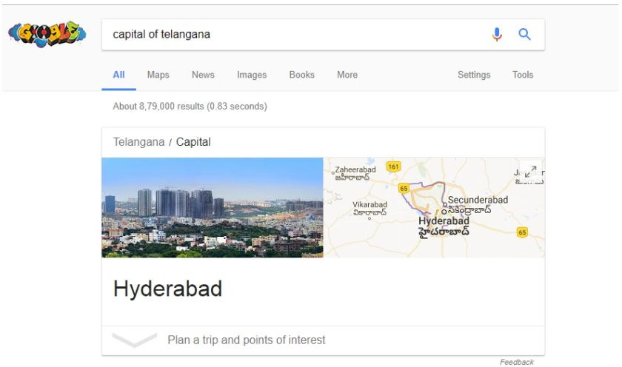
Search Engine are moving towards QA!

Slide 5
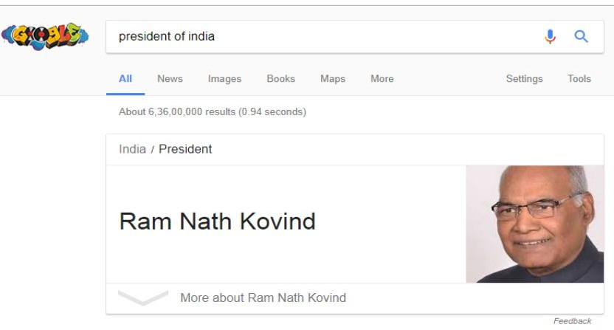
Search Engine are moving towards QA!

Slide 6
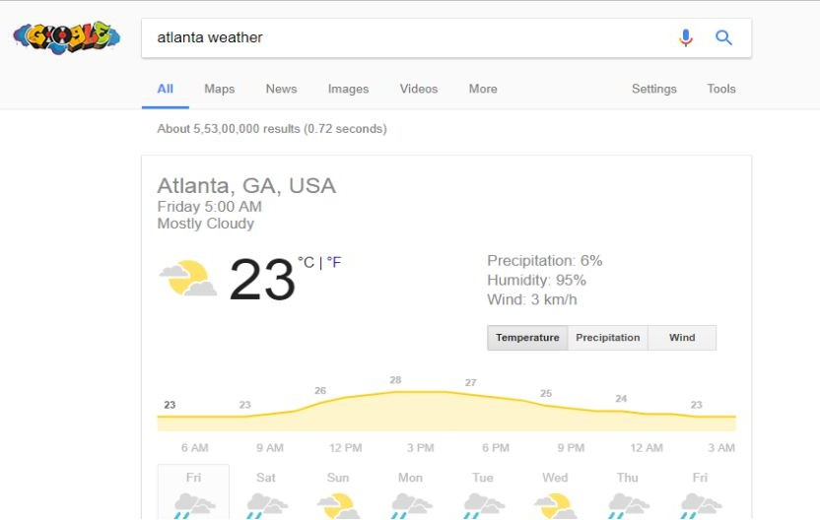
Search Engine are moving towards QA!

Slide 7
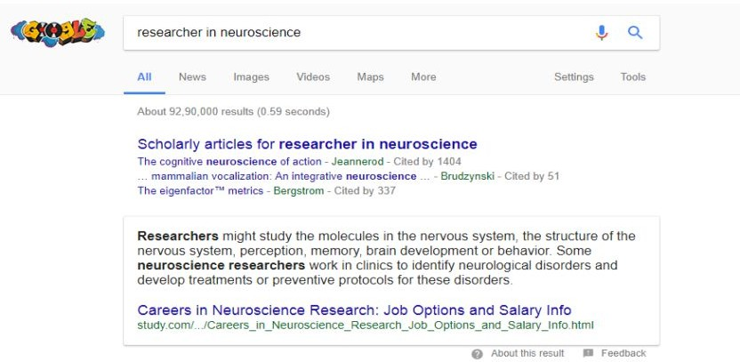
Search Engine are moving towards QA!

Slide 8
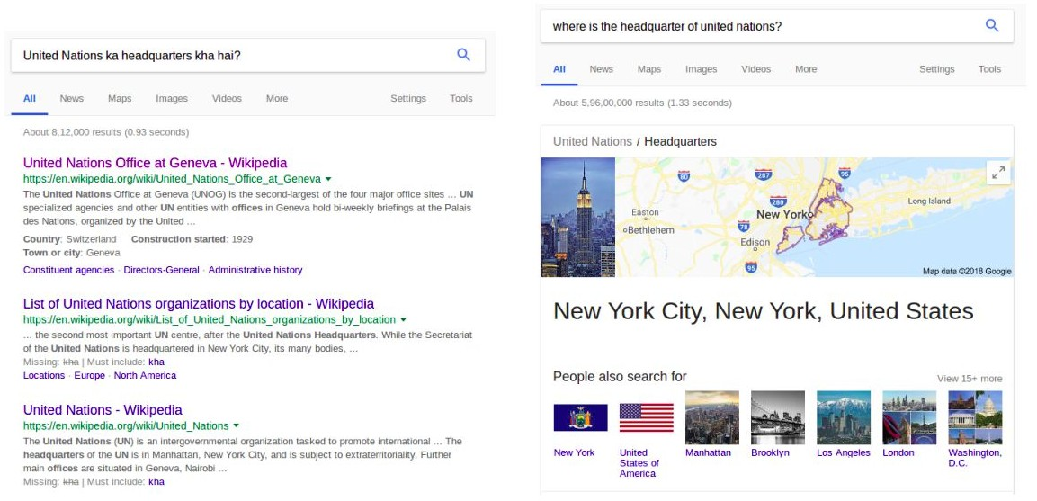
Search Engine are moving towards QA!

Slide 9
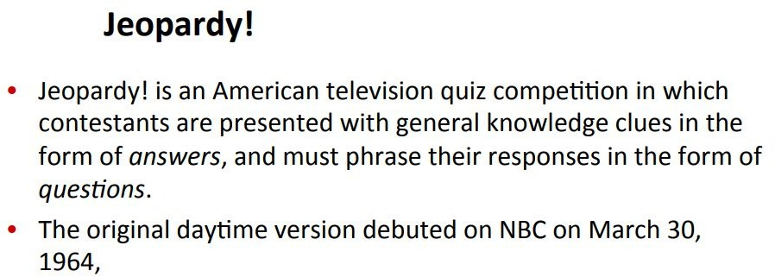
Question Answering: IBM’s Watson
Won Jeopardy on February 16, 2011!
IBM’s Watson is a Question Answering system.

Slide 10
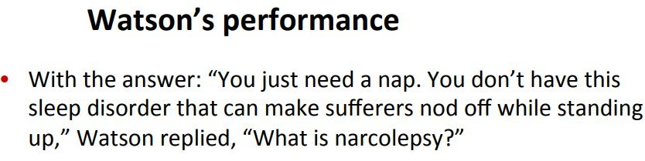
Question Answering: IBM’s Watson
Won Jeopardy on February 16, 2011!
IBM’s Watson is a Question Answering system.

Slide 11
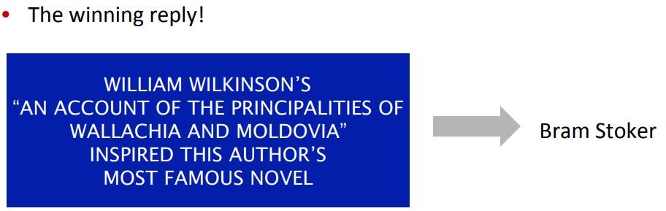
Question Answering: IBM’s Watson
Won Jeopardy on February 16, 2011!
IBM’s Watson is a Question Answering system.

Slide 12
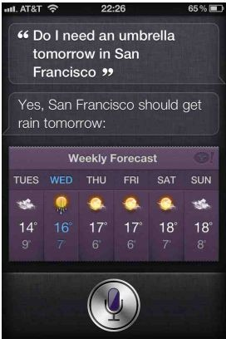
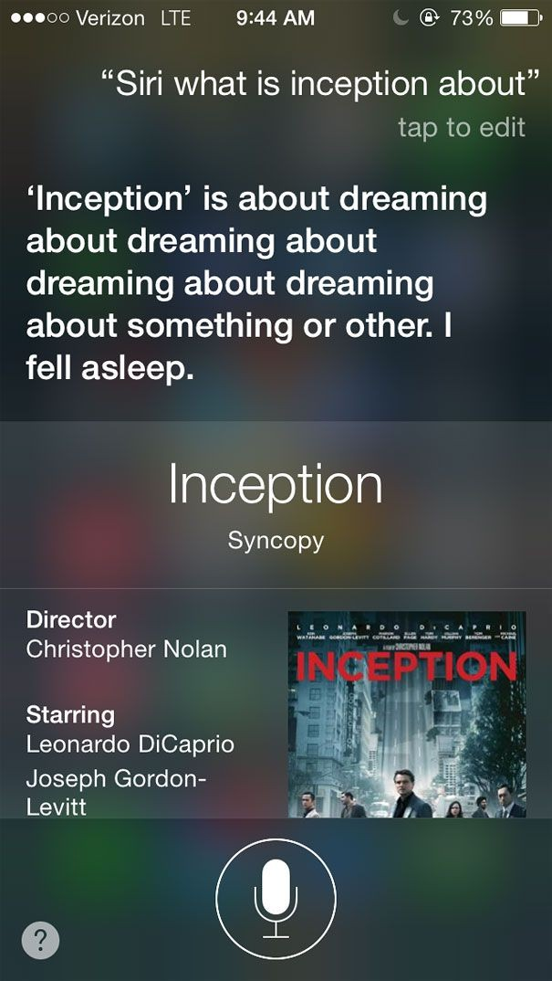
Apple Siri

Slide 13
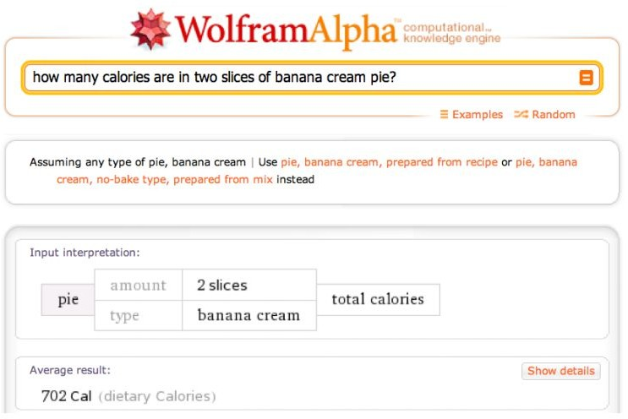

Slide 14
Motivation
Conversational Agents: Facebook Google etc.
(M), Apple (Siri),
Google Assistant: Ask it questions. Tell it to do things.
Jeopardy!: In 2011, the IBM Watson computer system competed on Jeopardy! against former winners and won the first place prize.
Biomedical and Clinical QA: Urgent need of system that accepts the queries from medical practitioners in natural language and returns the answers quickly and efficiently from biomedical literature, EMR etc.
Online knowledge service: The online service provide the answer of various question from science, mathematics etc.

Slide 15
Motivation and History
Open domain QA systems received larger attention in the 90s
  Combination of NLP and IR/IE techniques
  One of the most famous: MIT START system
  Wolfram Alpha
Advanced systems use a combination of “shallow” methods together with knowledge bases and more complex NLP methods.
In the last 20 years, TREC, SemEval and ACL provided workshops and tracks for various flavor of QA tasks (closed and open-domain)

Slide 16
Motivation and History (cont’d…)
Lately, a large number of new datasets and tasks have become available which have improved the performance of (open-domain) QA systems
  VisualQA
    Given an image and a question in natural language, provide the correct answer
    600,000+ questions on more than 200,000 images
  SQuAD - Stanford QA Dataset
    Open-domain question answering
    100,000+ Q-A pairs on 500+ articles
  NewsQA dataset
    Crowd-sourced machine reading comprehension dataset
    120,000 answered questions Over 12,000 news articles
We are build a comparable QA dataset from two language English & Hindi

Slide 17
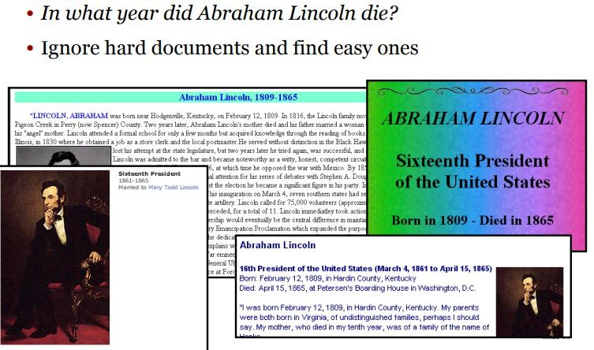
AskMSR: Shallow approach

Slide 18
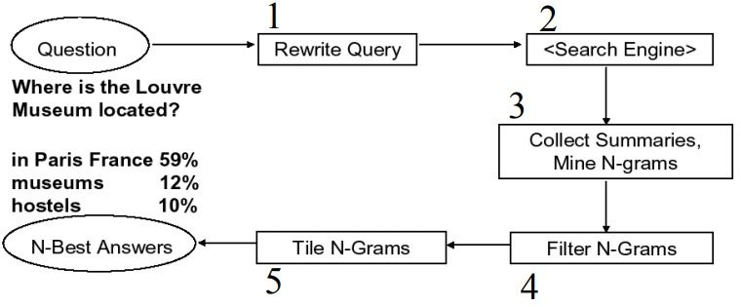
AskMSR: Details

Slide 19
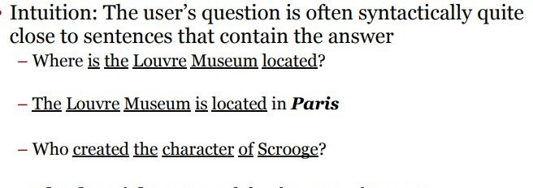
Step 1: Rewrite queries

Slide 20
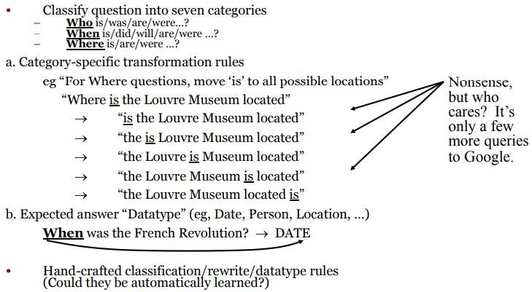
Query rewriting

Slide 21
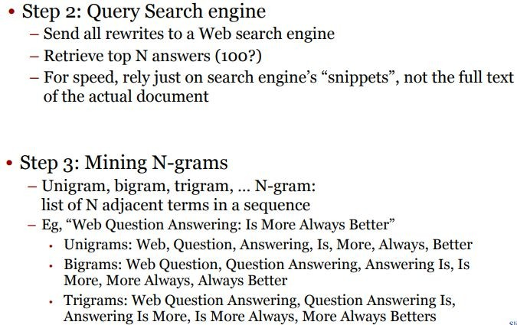
Next Steps

Slide 22
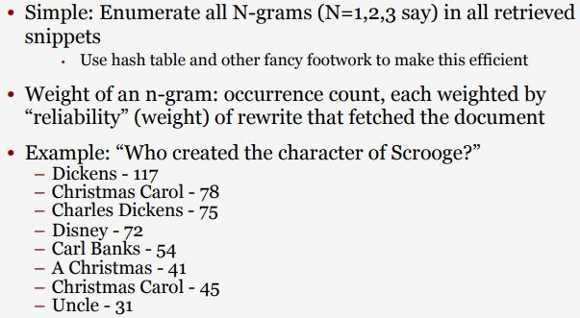
Mining N-Grams

Slide 23
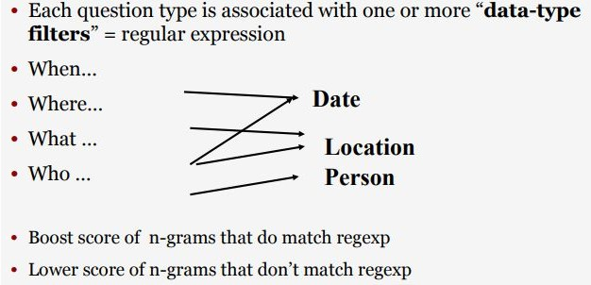
Filtering N-Grams

Slide 24

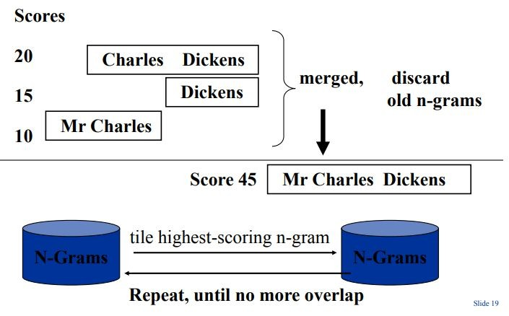
Tiling the Answers

Slide 25
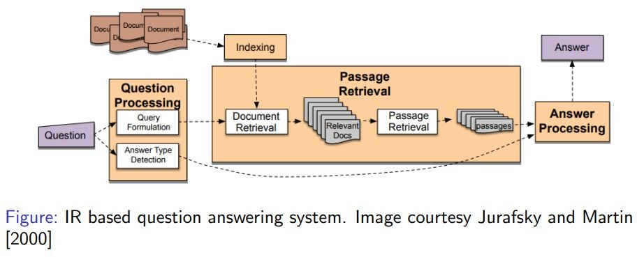
Basic Q/A Architecture

Slide 26
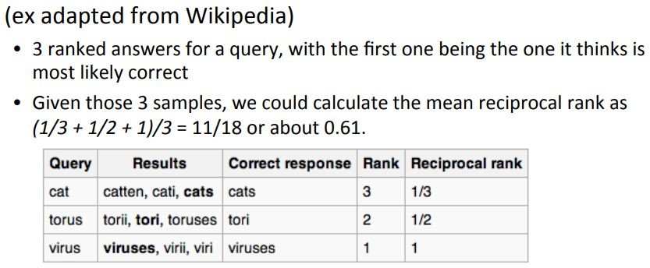
Common Evaluation Metrics
Accuracy (does answer match gold-labeled answer?)
Mean Reciprocal Rank:
– The reciprocal
rank of the
a query response is the
inverse of
the
– The ranks
rank of
first
correct
answer.
mean reciprocal rank
the reciprocal sample of queries Q.
is the average of
of results for a

Slide 27
Machine Comprehension
Machine Comprehension or Machine Reading Comprehension (MRC) is all about answering a query about a given context paragraph.
“A machine comprehends a passage of text if, for any question regarding that text that can be answered correctly by a majority of native speakers, that machine can provide a string which those speakers would agree both answers that question, and does not contain information irrelevant to that question.”
(Burges 2013)

Slide 28
A Brief History of Machine Comprehension
Much early NLP work attempted reading comprehension
  Schank, Abelson, Lehnert et al. c. 1977 – “Yale A.I. Project”
Revived by Lynette Hirschman in 1999:
  Could NLP systems answer human reading comprehension questions for 3rd to 6th graders? Simple methods attempted.
Revived again by Chris Burges in 2013 with MCTest
  Again answering questions over simple story texts
Floodgates opened in 2015/16 with the production of large datasets which permit supervised neural systems to be built
  Hermann et al. (NIPS 2015) DeepMind CNN/DM dataset
  Rajpurkar et al. (EMNLP 2016) SQuAD
  MS MARCO, TriviaQA, RACE, NewsQA, NarrativeQA, HotpotQA

Slide 29
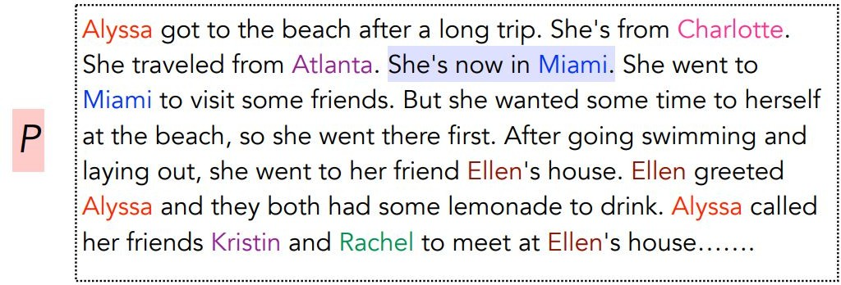


Machine Comprehension

Slide 30
Motivation (1)
Teaching machines to understand human language is a long-standing challenge in AI.
Requires various aspects of text understanding.
  Part-of-speech Tagging
  Named Entity Recognition
  Syntactic Parsing
  Coreference resolution
Is there a comprehensive evaluation that can test all
these aspects and probe understanding?
– Machine Comprehension
even deeper levels of

Slide 31
Motivation (2)
Reading comprehension: tests to measure how well a human has understood a piece of text.
Machine comprehension: how well computer systems understand human language.
Machine comprehension could be the most suitable task for evaluating language understanding

Slide 32
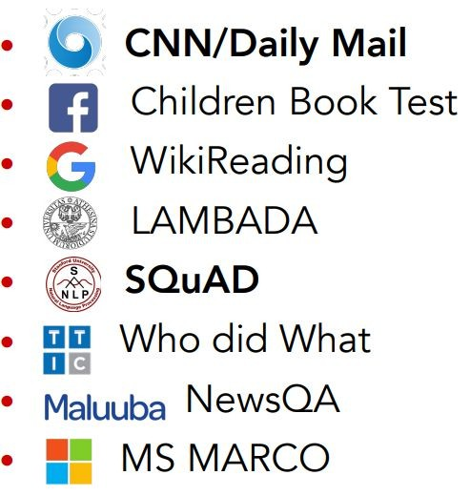
Datasets
Before 2015
After 2015
MCTest (Richardson et al, 2013): 2600 questions
ProcessBank (Berant et al, 2014): 500 questions

Slide 33
QA vs. Machine Comprehension
Reading comprehension as an instance of question answering because it is essentially a question answering problem over a short passage of text.
Question answering is to build computer systems which are able to automatically answer questions posed by humans from various sources.
Machine comprehension puts more emphasis on text understanding with answering questions regarded as a way to measure language understanding.

Slide 34
Approaches
Machine Learning Approaches
  Sliding Window (Richardson et. Al, 2013)
    Compute the unigram/bigram overlap between the sentence containing the candidate answer and the question.
    Use TF-IDF based similarity to select the best candidate answer.
  Logistic Regression (Rajpurkar et. Al, 2013)
    Extract several types of features for each candidate answer
    Features
      Matching Word Frequencies
      Matching Bigram Frequencies
      Lengths
      Span POS Tags
      …..

Slide 35
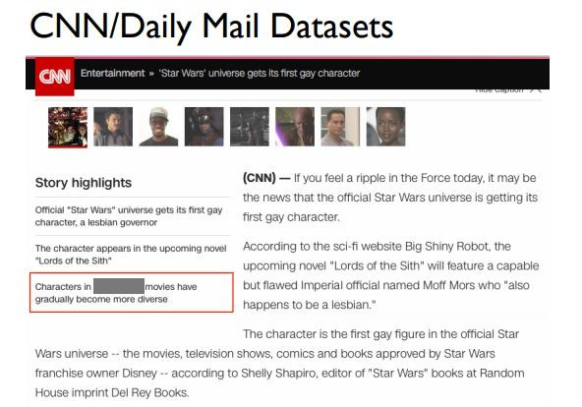
Approaches
Deep Learning Approaches
– Stanford Attentive Reader (Chen et al, 2016)

Slide 36
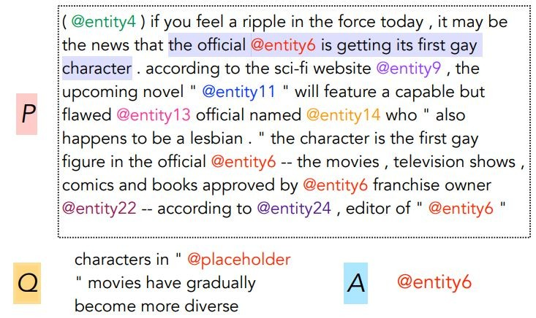
Deep Learning Approaches
– Stanford Attentive Reader (Chen et al, 2016)

Slide 37
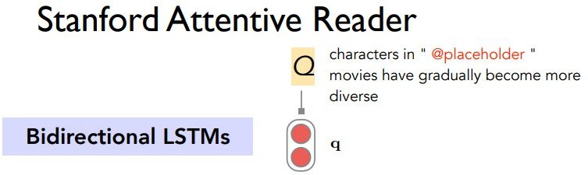
Deep Learning Approaches

Slide 38
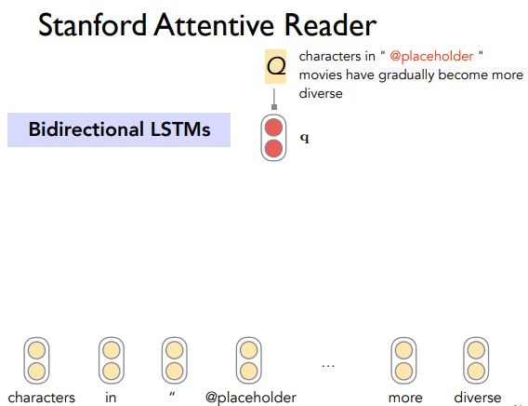
Deep Learning Approaches

Slide 39
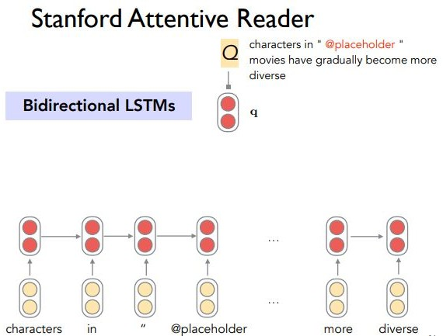
Deep Learning Approaches

Slide 40
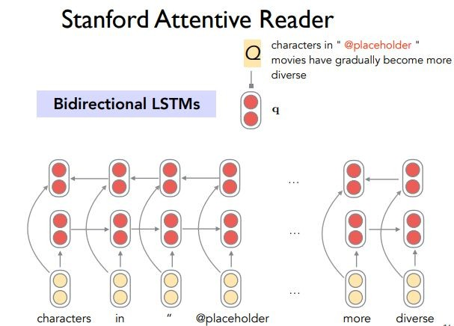
Deep Learning Approaches

Slide 41
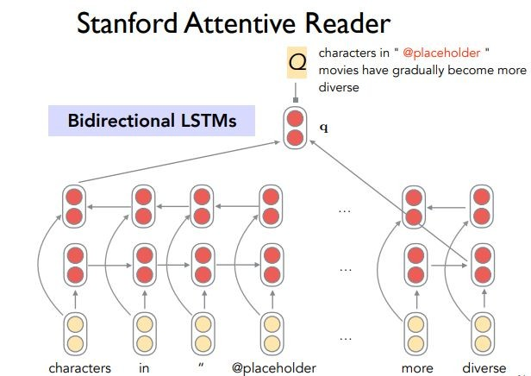
Deep Learning Approaches

Slide 42
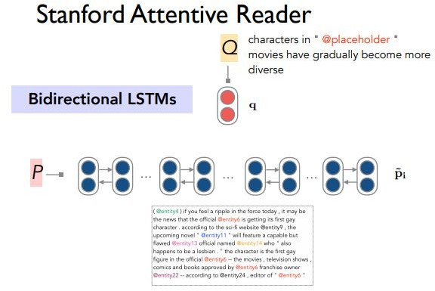
Deep Learning Approaches

Slide 43
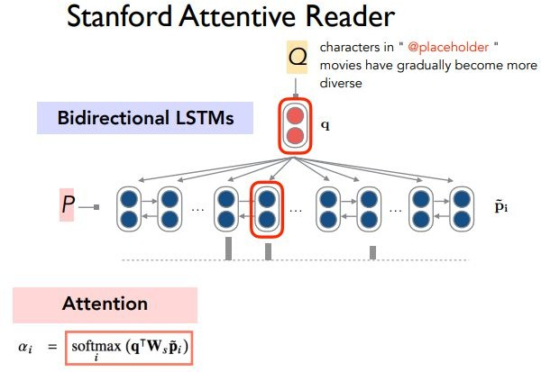
Deep Learning Approaches

Slide 44
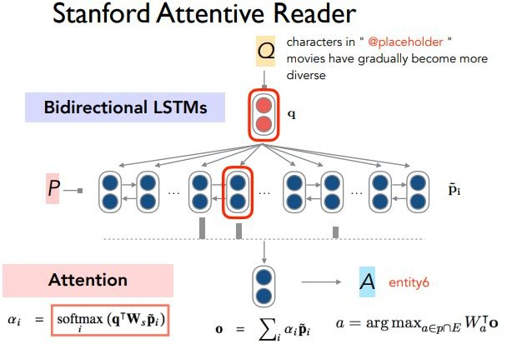
Deep Learning Approaches

Slide 45
Deep Learning Approaches
CNN/Daily Mail Datasets
Still noisy and artificial (not real questions)
Not hard enough for reasoning and inference
Does it work for a real QA problem?

Slide 46
Stanford Question Answering Dataset (SQuAD)
Passage + Question □ Answer
  Passage: selected from Wikipedia
  Question: crowdsourced
  Answer: must be a span in the passage
Extractive Question Answering

Slide 47
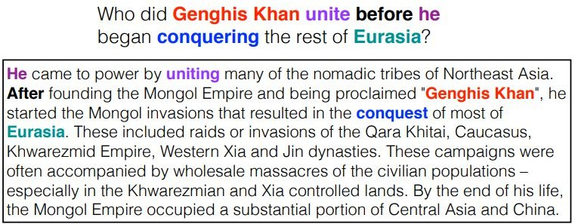
Stanford Question Answering Dataset (SQuAD)
Passage + Question □ Answer

Slide 48
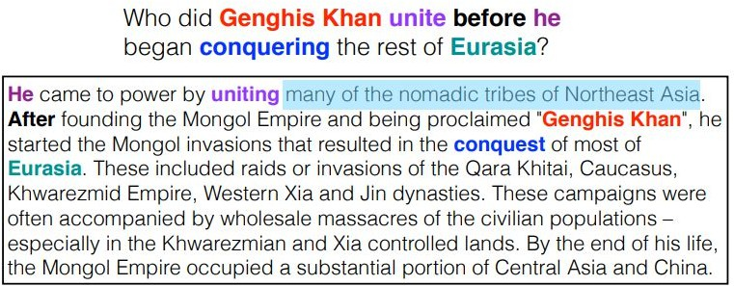
Stanford Question Answering Dataset (SQuAD)
Passage + Question □ Answer

Slide 49
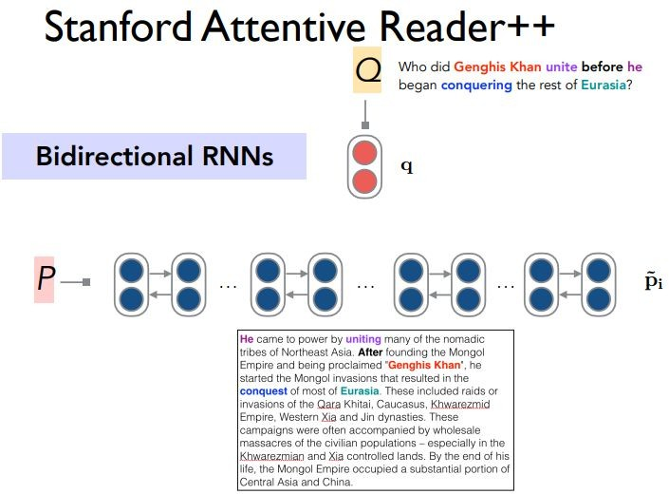
Deep Learning Approaches

Slide 50
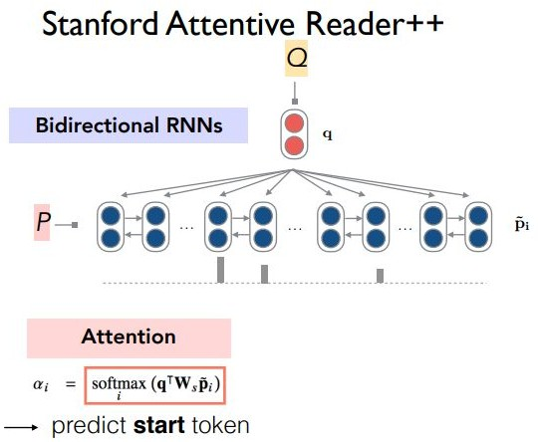
Deep Learning Approaches

Slide 51
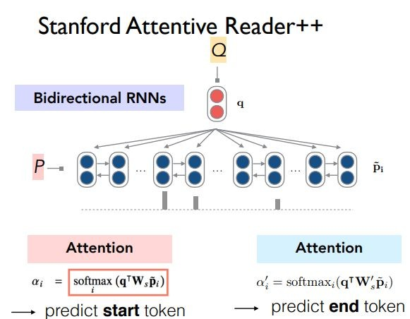
Deep Learning Approaches

Slide 52
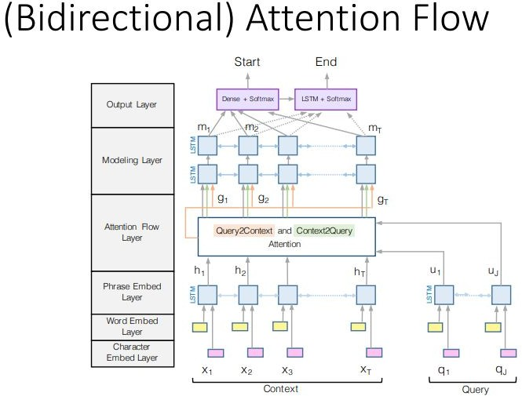
Deep Learning Approaches
(Minjoon et. Al, 2018)

Slide 53
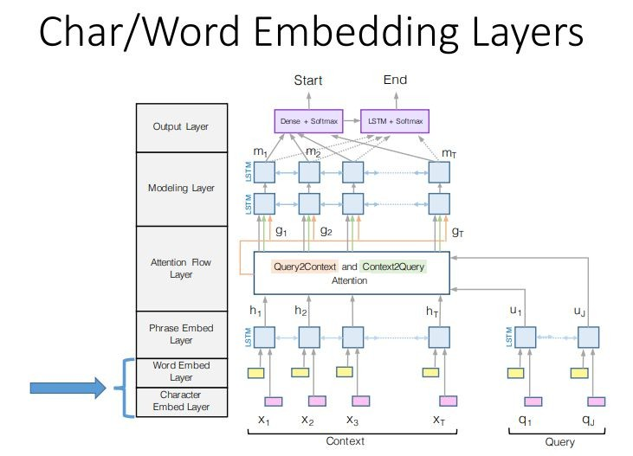
(Bidirectional) Attention Flow

Slide 54
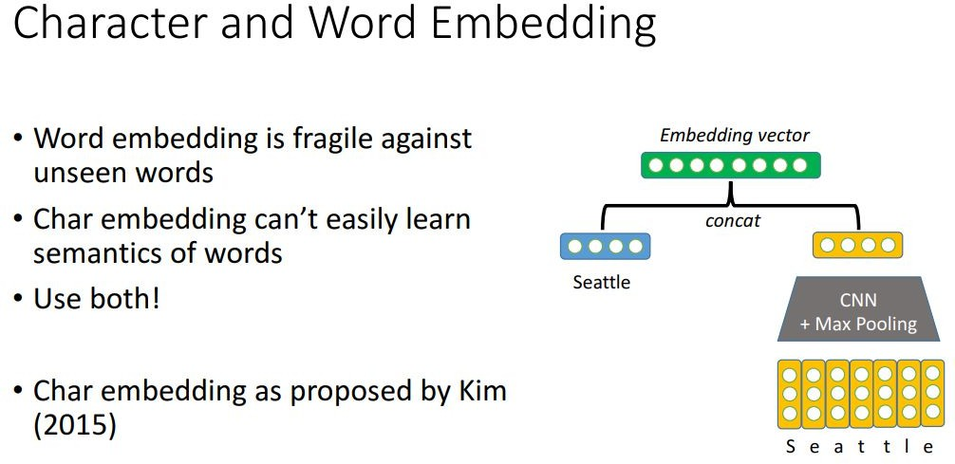
(Bidirectional) Attention Flow

Slide 55
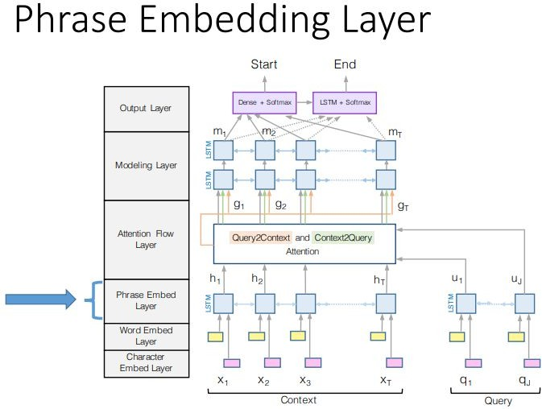
(Bidirectional) Attention Flow

Slide 56
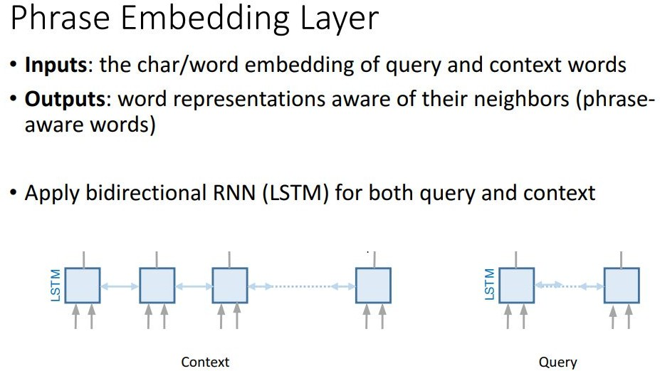
(Bidirectional) Attention Flow

Slide 57
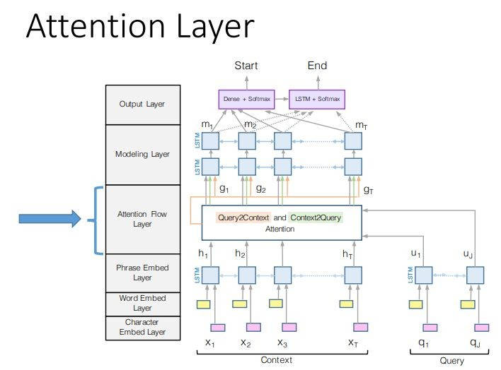
(Bidirectional) Attention Flow

Slide 58
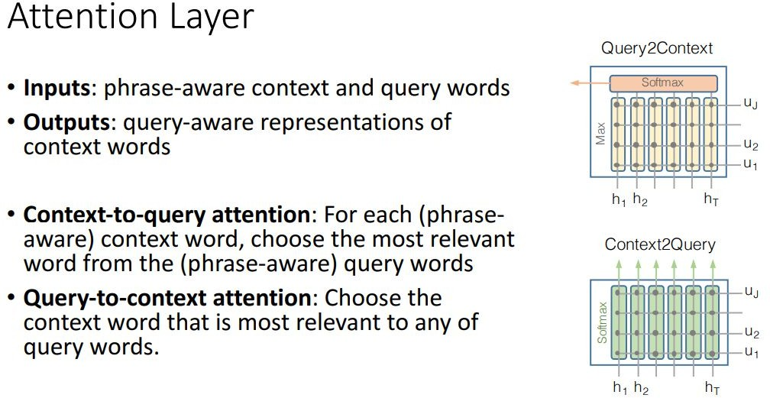
(Bidirectional) Attention Flow

Slide 59
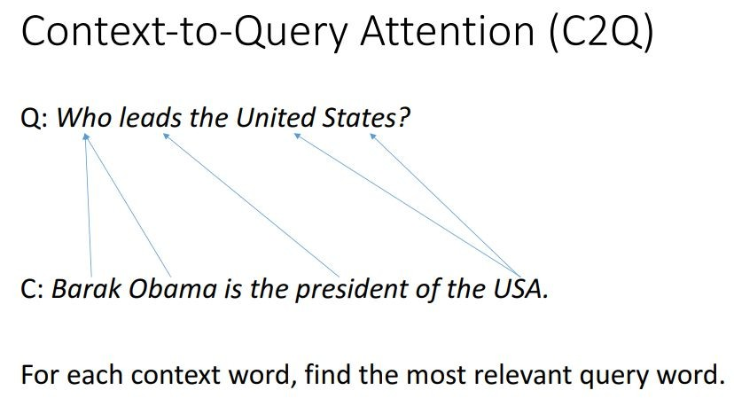
(Bidirectional) Attention Flow

Slide 60
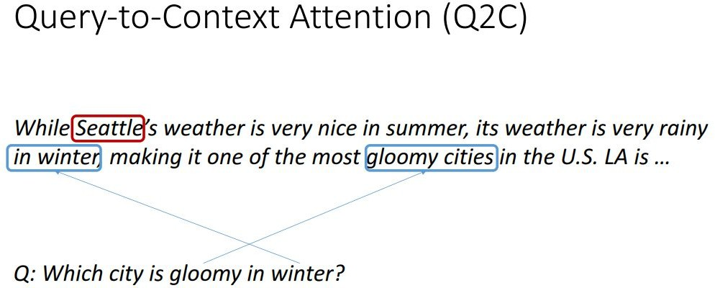
(Bidirectional) Attention Flow

Slide 61
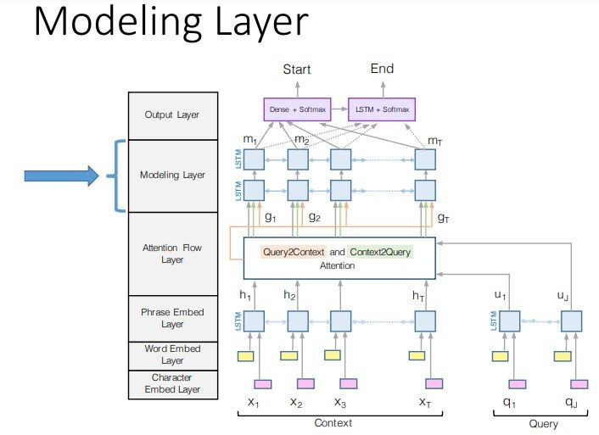
(Bidirectional) Attention Flow

Slide 62

(Bidirectional) Attention Flow

Slide 63

(Bidirectional) Attention Flow

Slide 64

Dense retrieval + generative models

Slide 65

Large language models can do open-domain QA well

Slide 66
For LLMs refer Unit-2
Knowledge based QA-refer class notes

Slide 67
References
Seo, Minjoon, et al. "Bidirectional attention flow for machine comprehension." arXiv preprint arXiv:1611.01603 (2016).
Chen, Danqi, Jason Bolton, and Christopher D. Manning. "A thorough examination of the cnn/daily mail reading comprehension task." arXiv preprint arXiv:1606.02858 (2016).
Manning, Christopher. "Natural Language Processing with Deep Learning CS224N/Ling284. Lecture 11." (2017).
Brill, Eric, Susan Dumais, and Michele Banko. "An analysis of the AskMSR question-answering system." Proceedings of the ACL-02 conference on Empirical methods in natural language processing-Volume 10. Association for Computational Linguistics, 2002.
Credit: Some of the slides are taken from the following lectures:
https://www.slideshare.net/marinasantini1/lecture-question-answering
https://web.stanford.edu/class/cs224n/slides/cs224n-2019-lecture10-QA.pdf

